Slide 1

Industry collaborations
at the SDSC
Spring 2020 - week #1

Slide 2
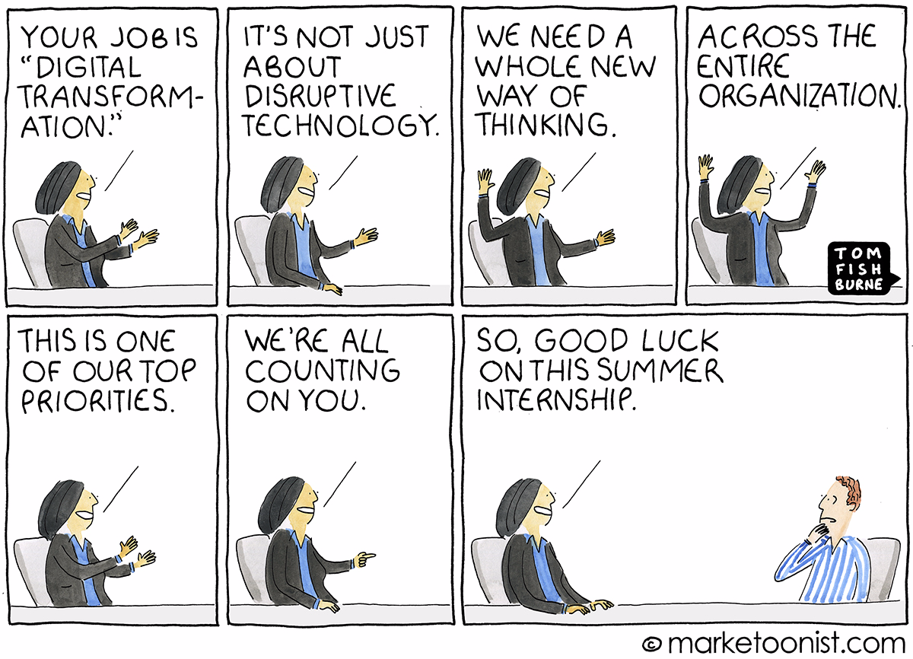
Your life in a few months?

Slide 3

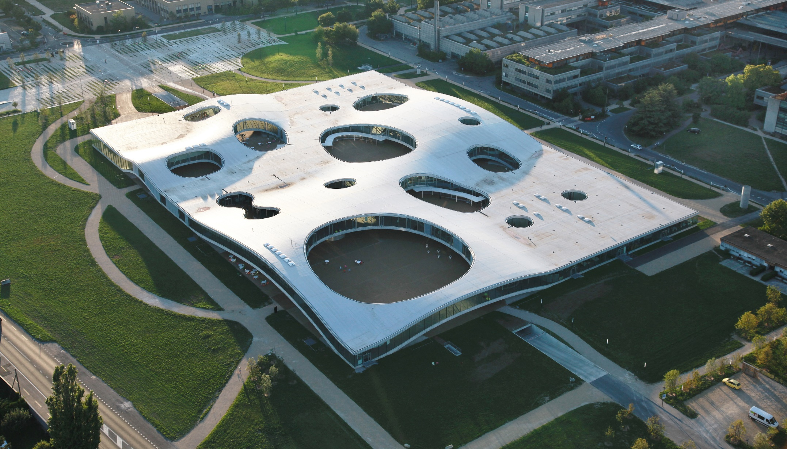






Our mission is to accelerate the adoption of data science and AI in Switzerland
An initiative from the ETH Domain, started in 2017
Growing to 50+ full-time professionals
Offices in Zurich and Lausanne
30 academic projects and 6 industry collaborations
Academic projects
Industry collaborations
RENKU platform

Slide 4



Why industry collaborations?
There is a gap between data scientists and domain experts which limits the impact of AI in companies
There is a need for external talents to provide innovative solutions to business challenges
There is a wish to be accompanied in the data-driven journey by a neutral partner

Slide 5


How do we support the Swiss Industry ?
We deliver proof of concepts solving your business challenges with embedded data scientists
We provide expertise in machine learning, time series analysis, computer vision and natural language processing

Slide 6
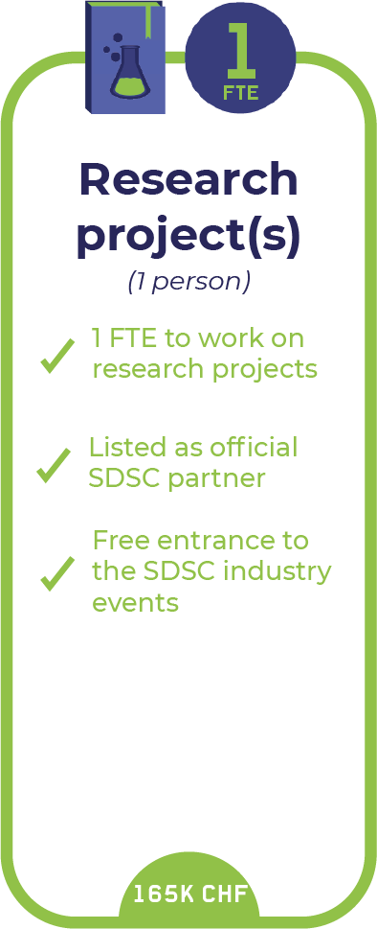
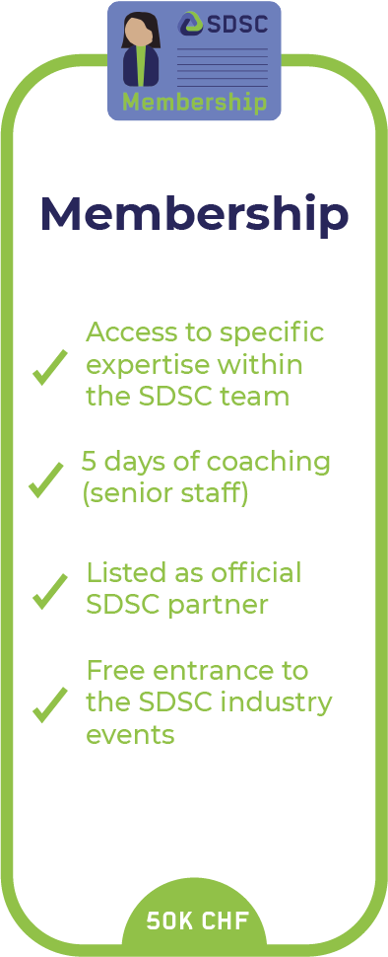
Overview of our collaboration models
and/or

Slide 7
Our use cases (so far)
Industries
Expertise
Use cases
Energy
Food
Pharma
Luxury
Banking
Perfume
Data Visualization
Forecasting
Machine Learning
Natural Language Processing
Computer Vision
Lead targeting
Customer segmentation
Churn prevention
Process control
Defect detection
News monitoring

Slide 8



We combine bottom-up with top-down approaches
Business objectives
Bottom up
Use cases
Top down
Available data
New data

Slide 9
From the first meeting to the project start
Use cases
Hiring
Hire Data Scientist with the right profile
Contract
Prepare contract based on existing templates
Data access
Define best way to access data
Define and prioritize use cases
First meeting
Project start

Slide 10
Selected 2019 projects
Company/Sector | Topics
Global food, feed & advanced materials company | Topic modelling/event detection regarding food safety Insights & recommendations on rice milling process
Luxury holding | Understand and forecast watch repair activities Analyze high jewellery customer journey
Private bank | Investigate information extraction strategies on open data for reputation analysis/topic discovery
Renewable energy provider | Computer-aided prospection based on census data
Global healthcare company | Identify key parameters influencing patients’ adherence & persistence to a treatment

Slide 11



Our partners’ benefits from working with the SDSC
The resources and flexibility of our team to solve data science challenges
The right place to foster innovation and continuous learning
Objectivity and cost efficiency with our mandates from the Swiss Confederation

